Slide 1


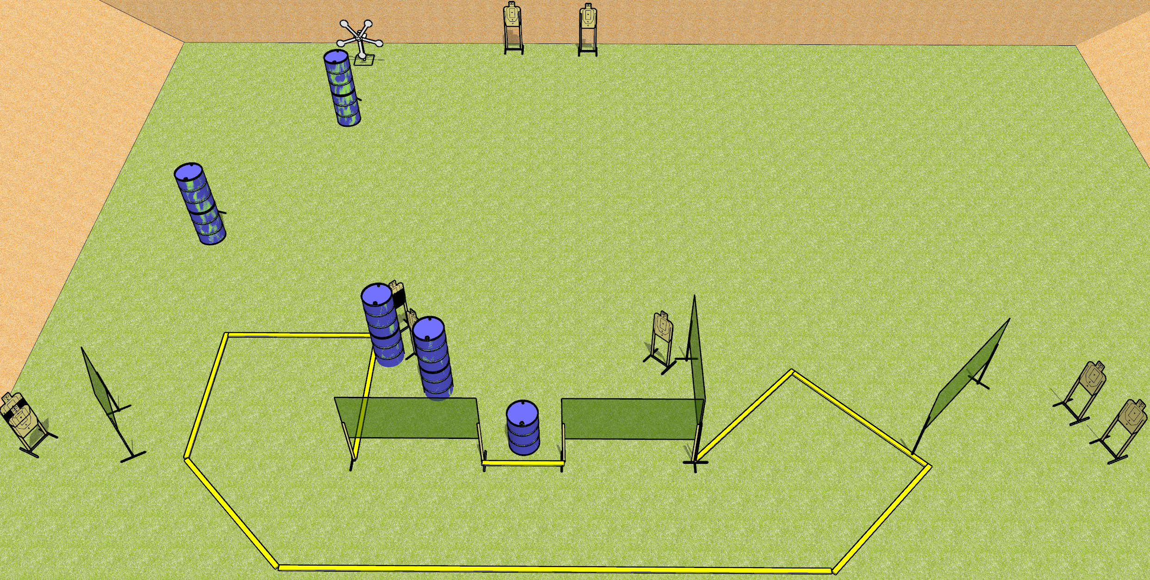
 | Dothan Gun Club – USPSA Match Not a Star Pun Course Designer : Drew Coleman
Round Count 27 rounds 11 USPSA targets 5 falling plates
Equipment List 1 Texas star 1 medium fault line 7 wall feet

Slide 2
Not a Star Pun
Written Stage Briefing
Not a Star Pun is a 27 round, 135 point, Comstock field course. There are 11 USPSA targets and 5 falling plates. The best 2 hits on paper will score and steel must fall to score. The start signal is audible.
Start position is toes touching the small fault line between the two walls (circled on diagram), palms flat on thighs. Firearm is on barrel, unloaded, laying unsupported with trigger guard on mark. All magazines are on belt.
Stage Procedure

